Slide 1
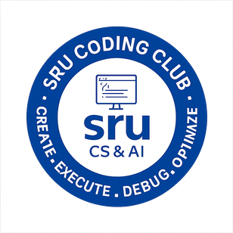


UdbhavaX'26
Project Title: Geriatic chronic care coordination hub
Domain: HT-04 (Health Tech)
Team Name: team echo
Team Members: Siddhartha , Afrin Sulthana ,Ramvardhan , vyshnavi
Department: ECE
Event: Udbhava X’26, Coding Club SR University

Slide 2
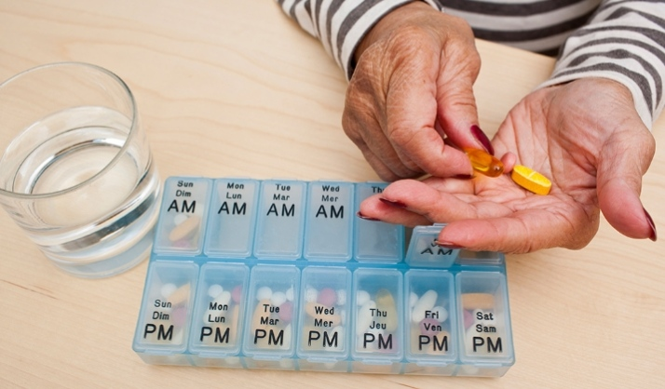
Problem Scenario
The Real World Situation:
Elderly patients with multiple chronic conditions (diabetes, hypertension, arthritis) often see 4–5 different specialists. Currently, these specialists rarely communicate. The cardiologist prescribes a drug that might negatively interact with a drug prescribed by the nephrologist. The patient, often dealing with cognitive decline, struggles to manage 10+ medications daily. Family caregivers are left in the dark about the overall treatment plan. The "siloed" nature of current EHRs (Electronic Health Records) leads to polypharmacy issues, accidental overdoses, and poor health outcomes for the elderly.
→ Most helplines still operate on a basic first-come, first-served model, without structured triage or intelligent prioritization.
→ As a result, low-risk callers may be attended to before someone in acute crisis. Counselors also receive little or no background context before speaking with a user, which wastes valuable time on repeated intake questions.
→ This creates an overloaded, inefficient, and unsafe system where high-risk individuals may be delayed, mismanaged, or overlooked.
codingclub@sru.edu.in

Slide 3
Current Pain Points (Why it Breaks)
→Lack of Communication Between Specialists
→olypharmacy (Too Many Medications)
→Cognitive decline affecting medication management
→No real-time health monitoring
→Low patient engagement with technology
codingclub@sru.edu.in

Slide 4
Objectives & Success Criteria
Primary Objective:
Create a centralized, user-friendly system that connects specialists, manages medications, and ensures safe, coordinated care for elderly patients.
Success Criteria:
Reduced medication errors and improved health outcomes through better communication, real-time alerts, and higher patient adherence.
codingclub@sru.edu.in

Slide 5
System Architecture
Architectural Overview (3-Tier):
→1. Presentation Layer (Frontend): User interfaces for patients, caregivers, and doctors (web/mobile dashboards) to view records, receive alerts, and manage medications.
2. Application Layer (Backend): Java-based server handling business logic, APIs, authentication, drug interaction checks, notifications, and communication between users.
3. Data Layer (Database): Centralized database storing patient records, prescriptions, health data, alerts, and logs with secure access control.
codingclub@sru.edu.in

Slide 6
Data Flow / Workflow
Patient details are entered into the system
Data is stored in the centralized database
Doctor adds prescriptions/medications
System performs drug interaction check
Alerts are generated if risks are detected
Medication schedule and reminders are created
Notifications are sent to patient and caregiver
Health data (BP, sugar, etc.) is monitored
Abnormal values trigger real-time alerts
Doctors review data and update treatment plan
codingclub@sru.edu.in

Slide 7
Impact & Benefits
For Users:
improved patient safety through reduced medication errors and drug interaction alerts
Better care coordination with seamless communication between doctors and caregivers
Enhanced health management via reminders, real-time monitoring, and easy access to records
codingclub@sru.edu.in

Slide 8
THANK YOU

